Slide 1
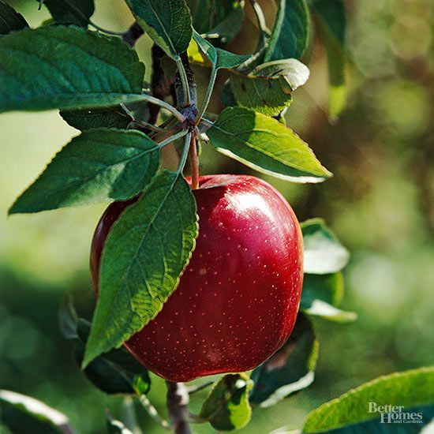
Plant Pathology 2021 - FGVC8
One Apple a day keep the Lecturer away

Slide 2

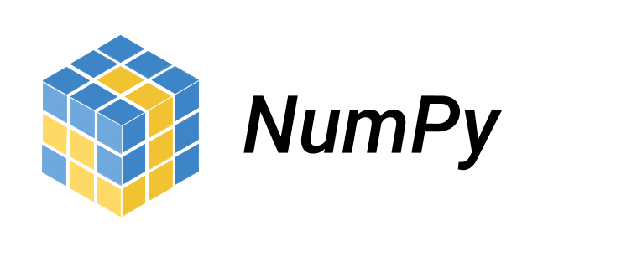



Libraries

Slide 3
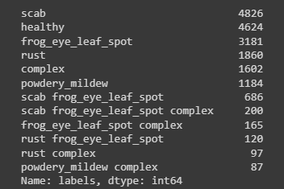
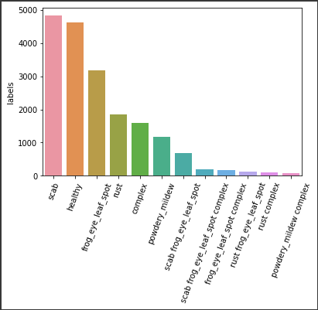
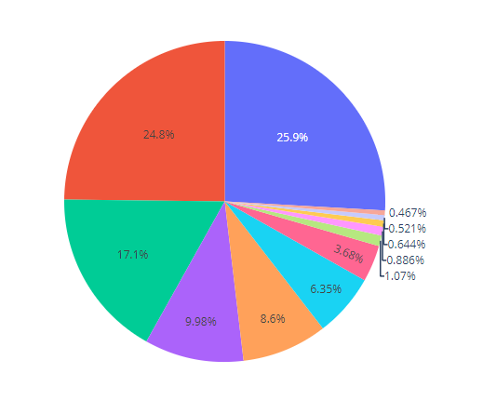
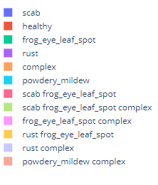
The Dataset

Slide 4
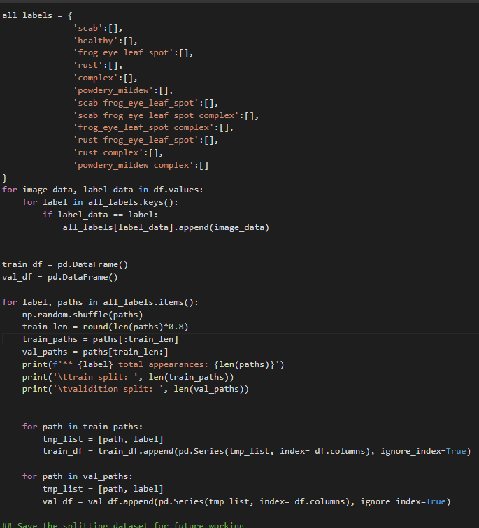
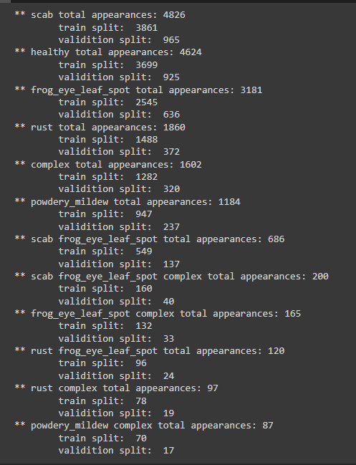
Dataset Split a customized stratified

Slide 5
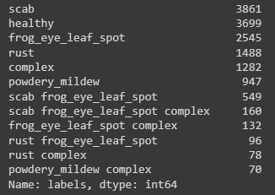
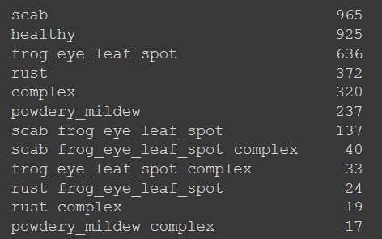
Dataset Split
Train 80%
Validation 20%

Slide 6

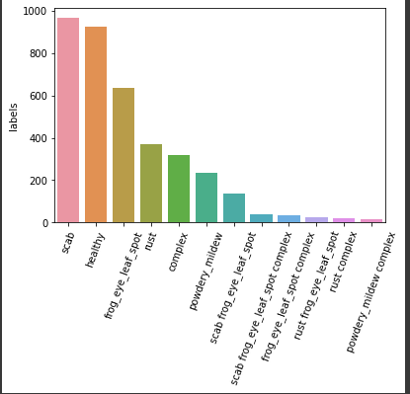
Dataset Split
Train
Validation

Slide 7
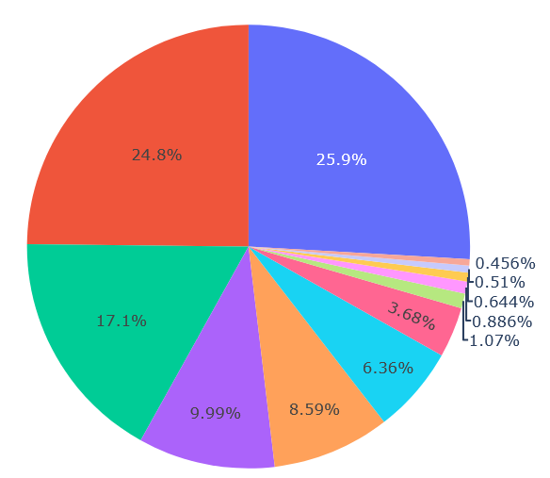
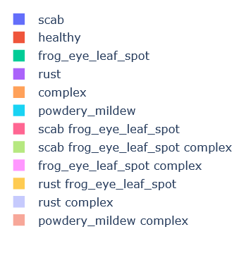
Dataset Split
Train
Validation

Slide 8
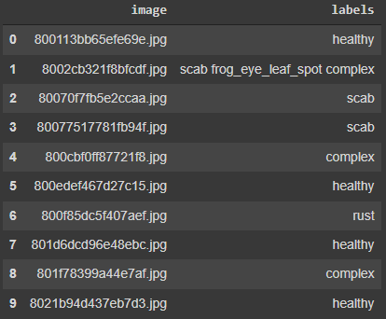
Raw Annotation File

Slide 9
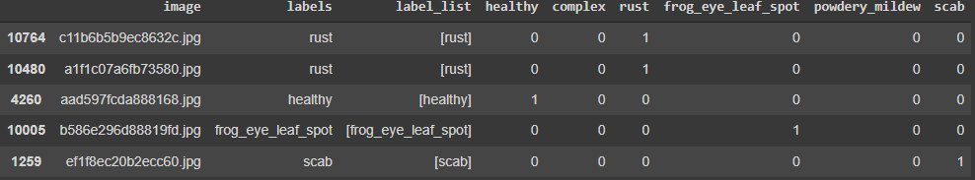
Multi Label One Hot Encoding

Slide 10
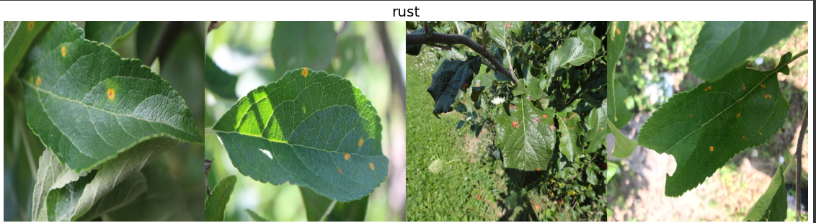
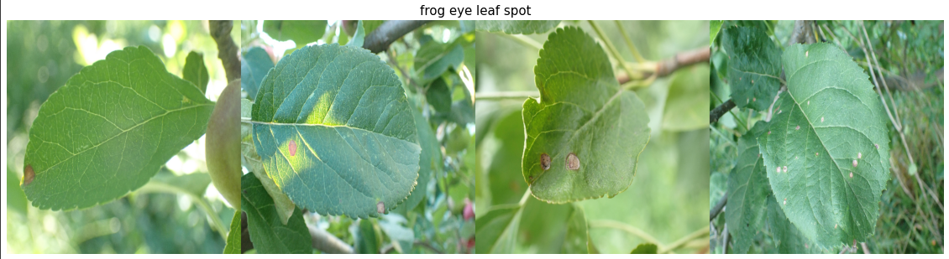
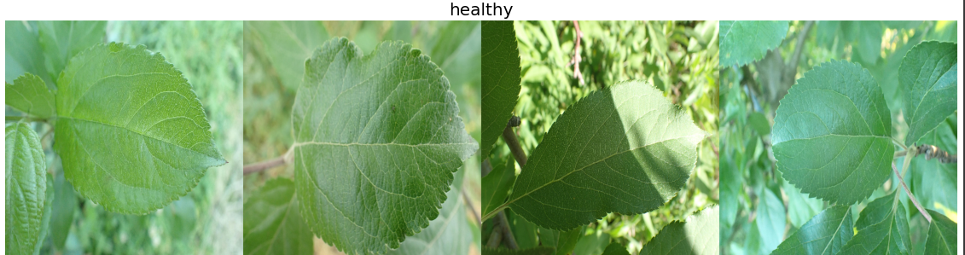
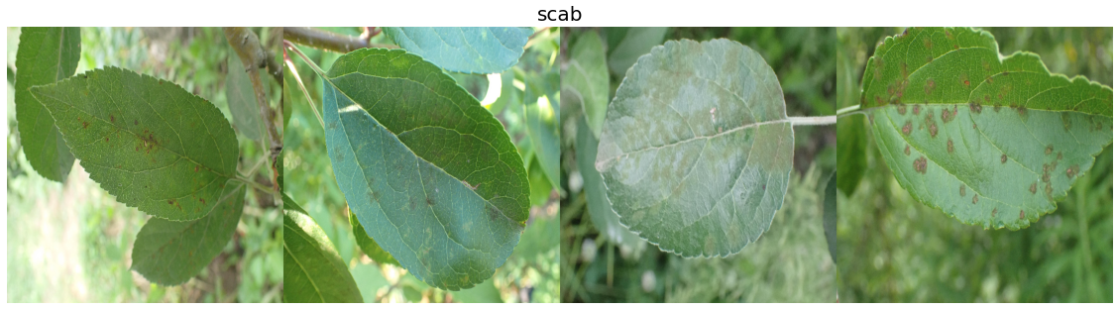
DataSet Pictures

Slide 11
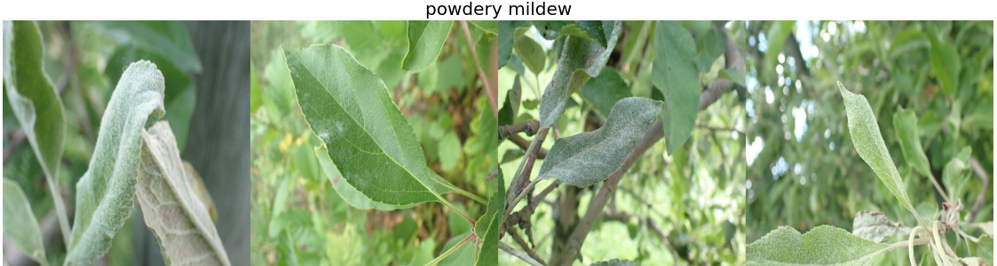
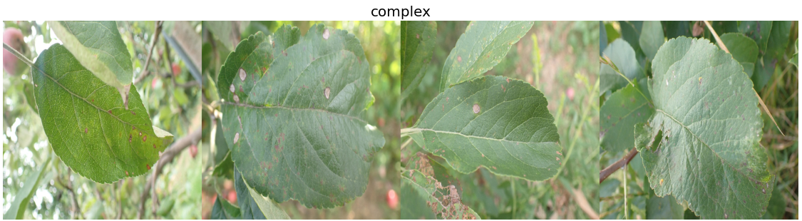
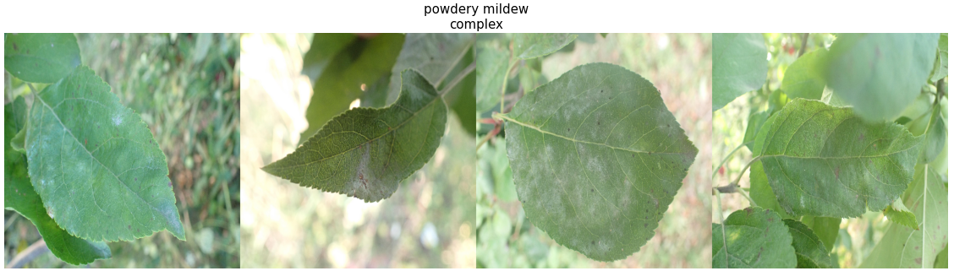
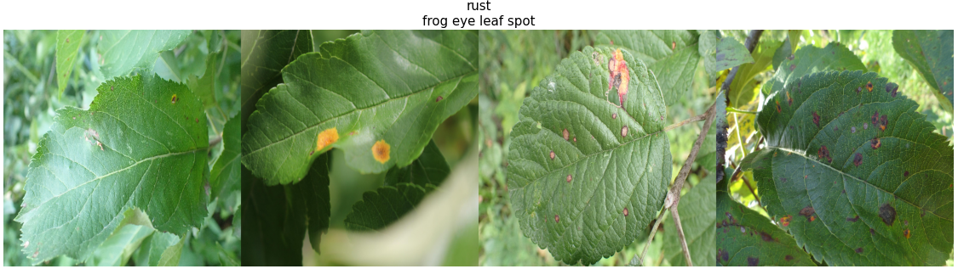
DataSet Pictures

Slide 12
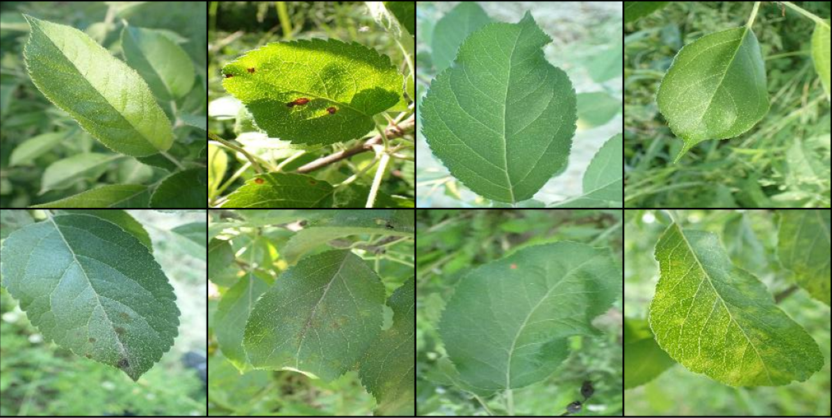
Augmentation

Slide 13
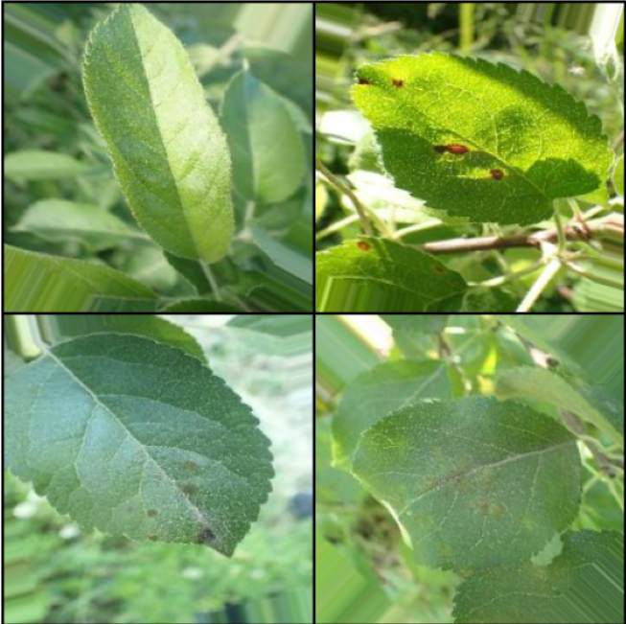
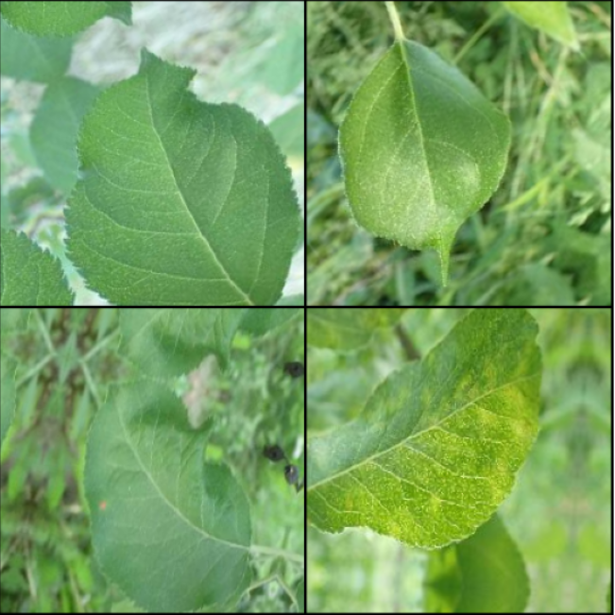
Rotate
ShiftScaleRotate

Slide 14
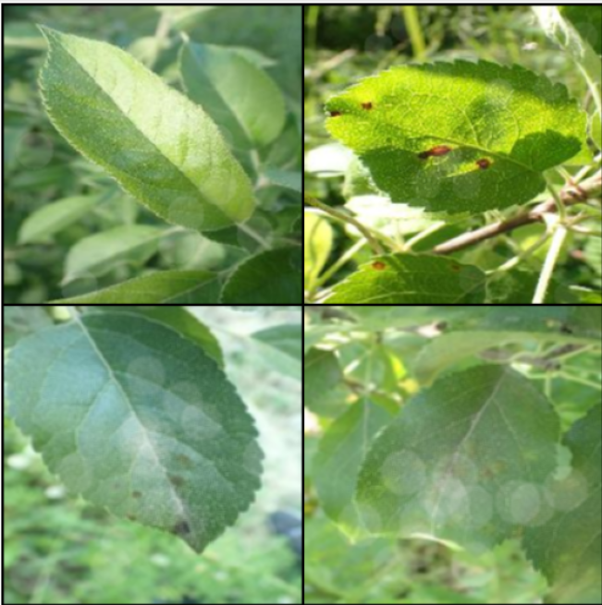
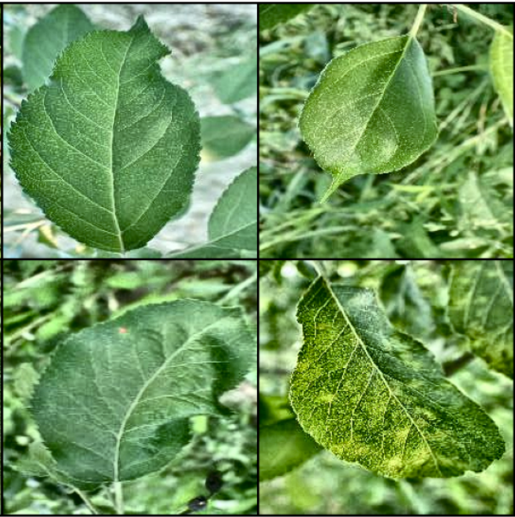
RandomFog
CLAHE

Slide 15
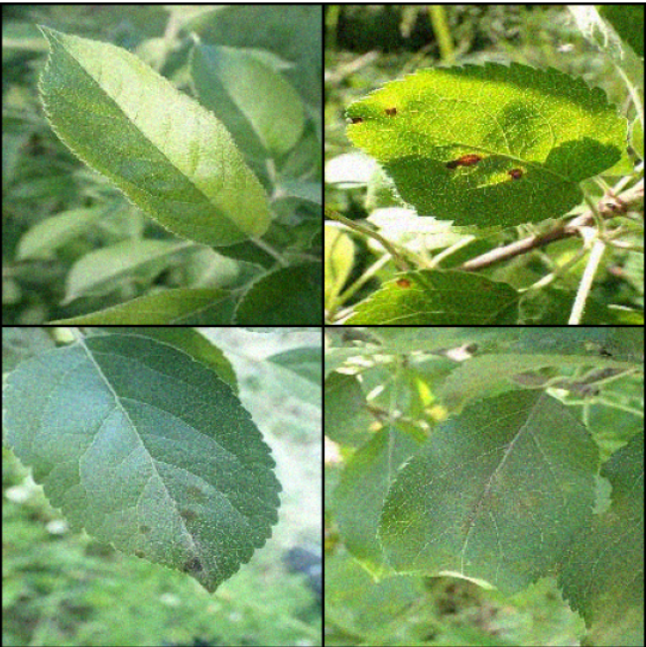
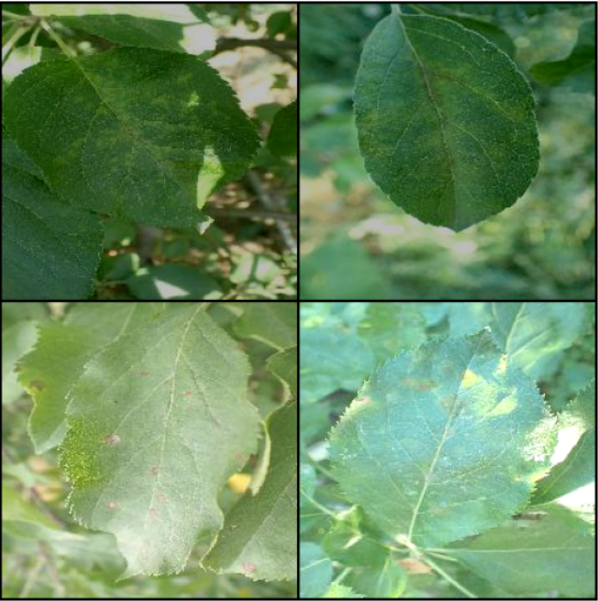
GaussNoise
RandomBrightnessContrast

Slide 16
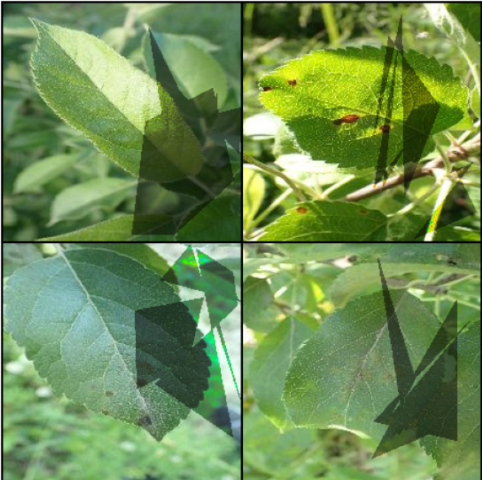
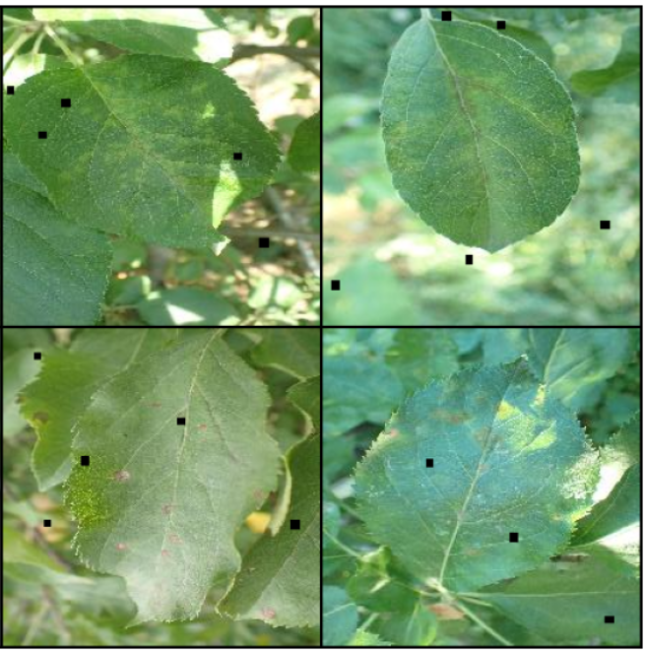
RandomShadow
CoarseDropout

Slide 17
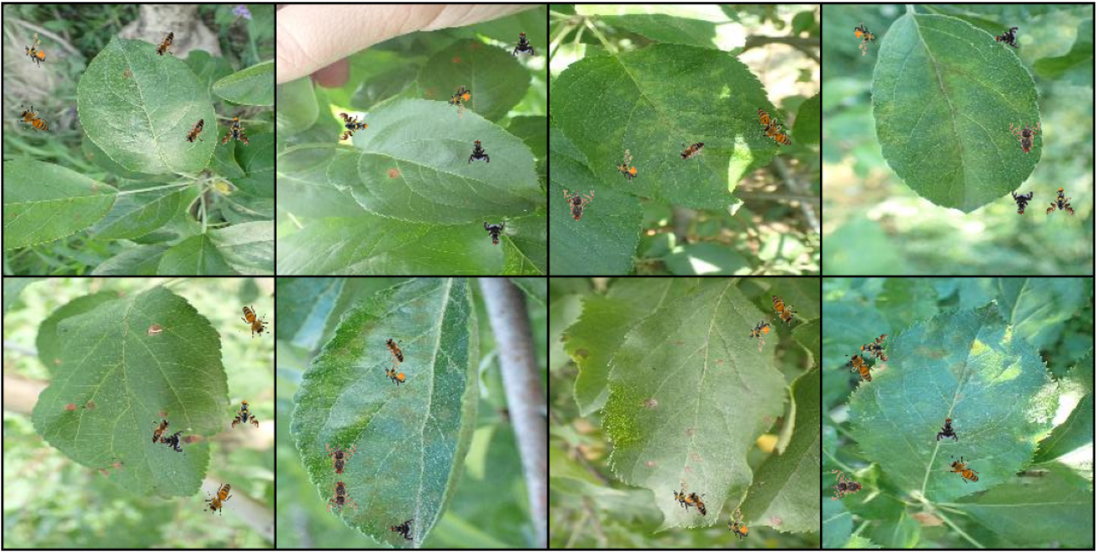
InsectAugmentation

Slide 18
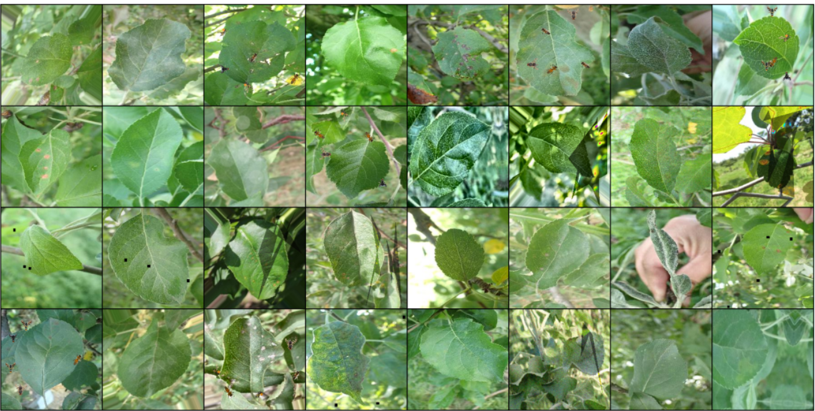

Slide 19
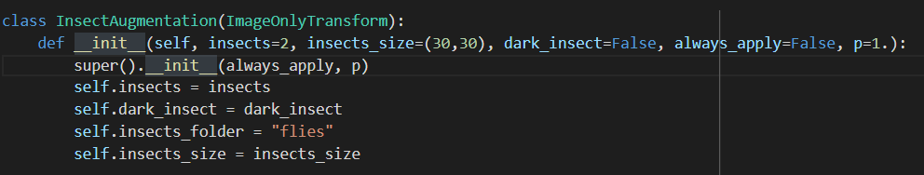
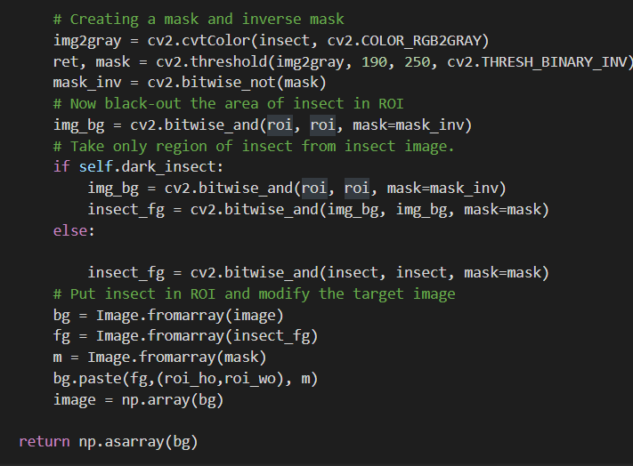
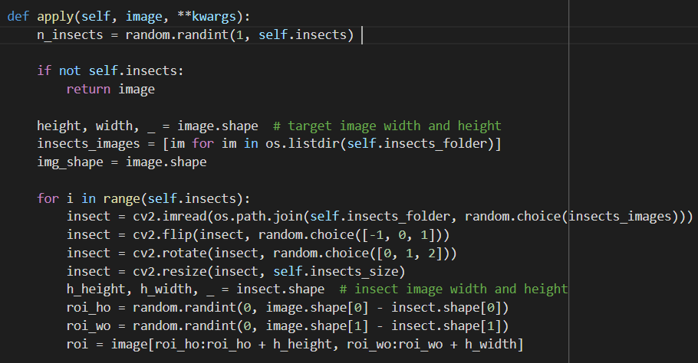

Slide 20
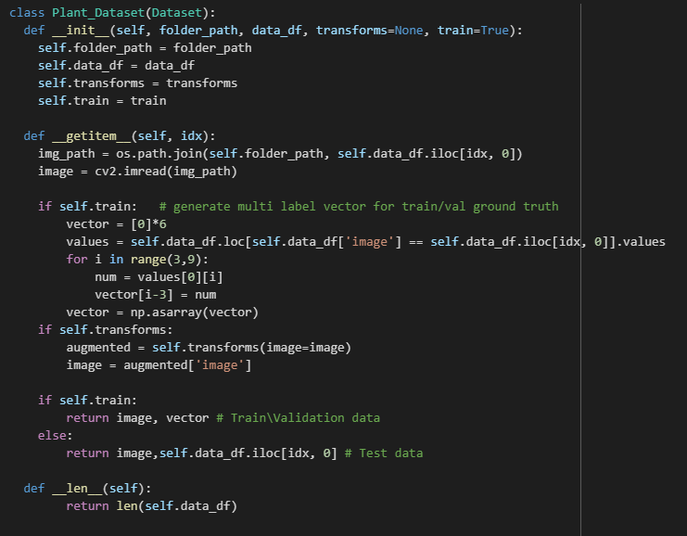
The Plant Dataset Class

Slide 21
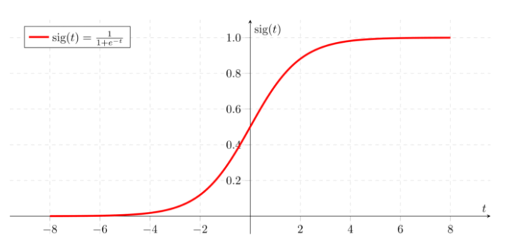
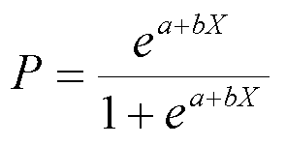
Logistic Regression
This type of statistical analysis is often used for predictive analytics and modeling, it is used in statistical software to understand the relationship between the dependent variable and one or more independent variables by estimating probabilities using a logistic regression equation.
This type of analysis can help you predict the likelihood of an event happening or a choice being made.

Slide 22
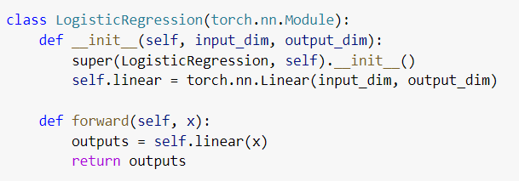
Logistic Regression
Training Hyperparameters:
epochs: 50
batch size: 100
learning rate:0.001
optimizer: SGD
augmentation: No

Slide 23
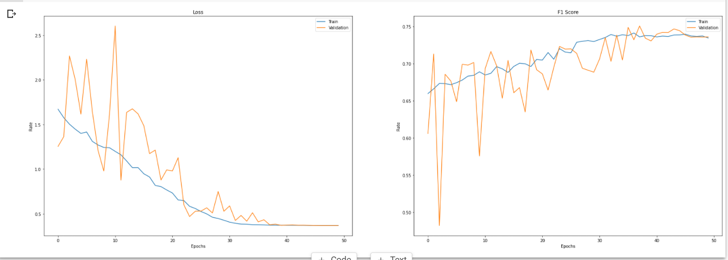
Logistic Regression
Final Train Loss: 0.36 Final Train F1 Score: 0.73
Final Validation Loss: 0.36 Final Validation F1 Score: 0.73

Slide 24
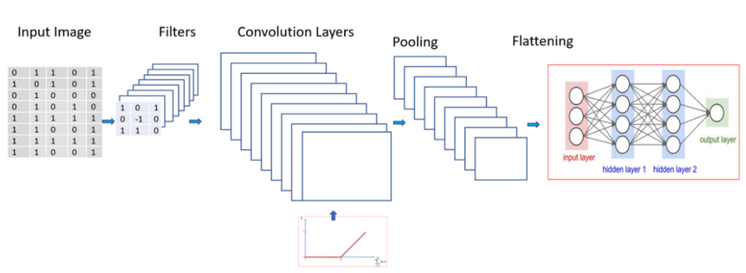
Convolutional Networks
They are a multi-layered neural network that is known to be able to detect patterns and complex features. The convolutional layers encode multiple lower-level features into more discriminative features, in a way that is spatially context-aware.

Slide 25
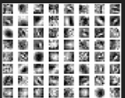
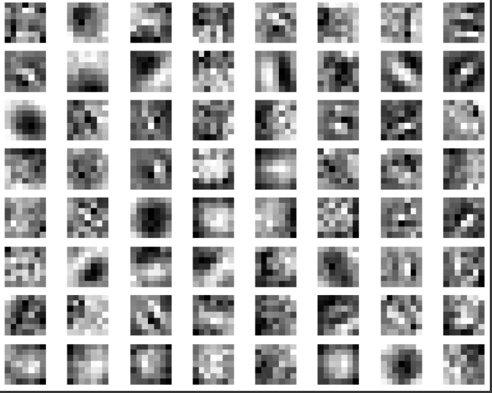
Filters / Feature Detectors
Notes:
CONV: Conv2d(3, 64, kernel_size=(7, 7), stride=(2, 2), padding=(3, 3), bias=False) ====> SHAPE: torch.Size([64, 3, 7, 7])
because in conv0 we have 7x7 filters and total of 64

Slide 26
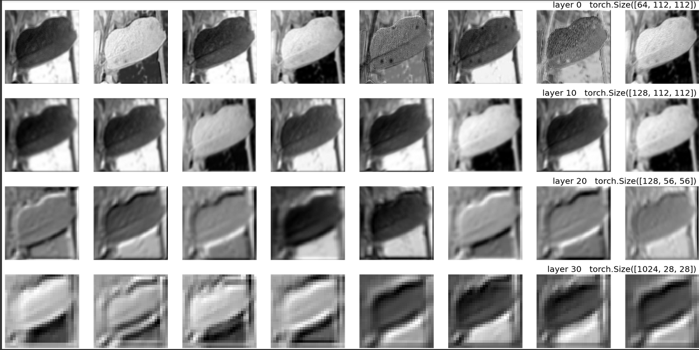
feature maps

Slide 27
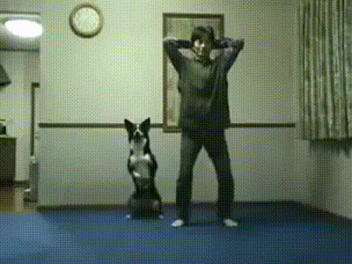
let’s talk about
how to train CNN

Slide 28
Optimizer
Optimizer is an algorithm or a method used to change the attributes of the neural network such as weights and learning rate to reduce the losses.
We use it to solve optimization problem by minimizing the function.
Adam is a replacement optimization algorithm for stochastic gradient descent for training deep learning models.Adam combines the best properties of the AdaGrad and RMSProp algorithms to provide an optimization algorithm that can handle sparse gradients on noisy problems.

Slide 29
Optimizer
Optimizer is an algorithm or a method used to change the attributes of the neural network such as weights and learning rate to reduce the losses.
We use it to solve optimization problem by minimizing the function.
Adam is a replacement optimization algorithm for stochastic gradient descent for training deep learning models.Adam combines the best properties of the AdaGrad and RMSProp algorithms to provide an optimization algorithm that can handle sparse gradients on noisy problems.

Slide 30
Scheduler
At the beginning of every epoch, this callback gets the updated learning rate value from schedule function provided, with the current epoch and current learning rate, and applies the updated learning rate on the optimizer.

Slide 31
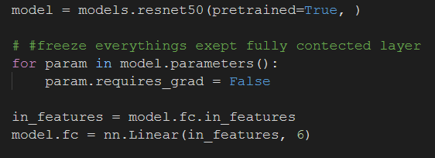
training tools
transfer learning

Slide 32
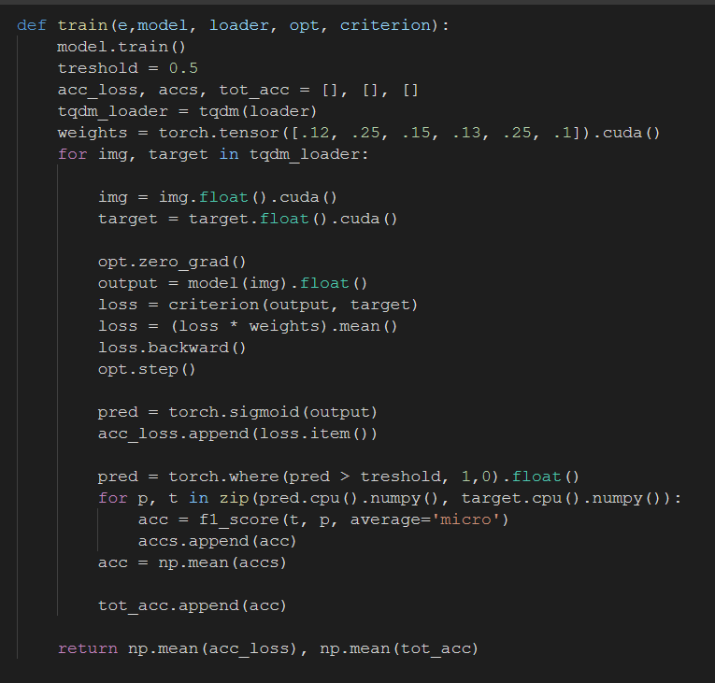
training function

Slide 33
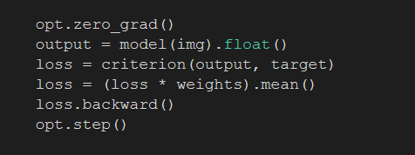
training loss

Slide 34

Calculating F1

Slide 35

validition function

Slide 36

validation loss

Slide 37
validation loss

Slide 38

Hyper parameter search

Slide 39

Hyper parameter search

Slide 40


Slide 41

VGG
VGG is a classical convolutional neural network architecture. It was based on an analysis of how to increase the depth of such networks. The network utilises small 3 x 3 filters. Otherwise the network is characterized by its simplicity: the only other components being pooling layers and a fully connected layer.

Slide 42


VGG
Hyper Parameters Search

Slide 43


VGG
training hyperparameters:
epochs: 50
batch size: 16
learning rate:0.0026
optimizer: AdamW
Scechulder:CosineAnnealing
augmentation: shown in photo

Slide 44

VGG
Final Train Loss: 0.15 Final Train F1 Score: 0.92
Final Validation Loss: 0.11 Final Validation F1 Score: 0.95

Slide 45

selected model - ResNet50
We chose the ResNet50 model, based on the Article we review.
But we can’t directly compare (evolution) scores, ResNet, short of Residual Networks is a classic neural network used as a backbone for many computer vision tasks. This model was the winner of ImageNet challenge in 2015. The fundamental breakthrough with ResNet was it allowed us to train extremely deep neural networks with 150+layers successfully. Prior to ResNet training very deep neural networks was difficult due to the problem of vanishing gradients.

Slide 46

ResNet50 - quick and dirty
training hyperparameters:
epochs: 30
batch size: 64
learning rate:0.05
optimizer: AdamW
augmentation: No

Slide 47



Slide 48


Slide 49


Slide 50

Training Hyperparameters:
epochs: 50
batch size: 16
learning rate:0.00423
optimizer: AdamW
augmentation: True

Slide 51



Slide 52


